Slide 1
Group ID : 12
Chapter – 2 : Proposed System requirement Gathering
2.1 – Stack Holder of System
2.2 – Requirement Gathering Technique used
2.3 – Consolidated List of Requirement
2.4 – Project Definition

Slide 2
Chapter – 2 Proposed System Requirement Gathering
2.1 - Stack holders of System :
Admin :- Admin involved in user management, risk management (like managing risk and fraud prevention), transaction monitoring, customer support, product management , Technical Support , Account Management.
Customer :- Account opening, perform transactions, apply for loans
Visitor:- Visit the website
Investors :- Equity investment , Manage investments , View Financial Activities .

Slide 3
PROPOSED SYSTEM REQUIREMENT GATHERING
Every software project goes through up phase called requirement gathering. A successful project begins with a difficult set of discussion on what should be done. Its major responsibility of IT business analysis gathers the requirement from the client. Getting the correct requirement from the client can often be one of the biggest hurdles in any software project. If business analysis gathers correct and complete requirement, the project will yield richer crops.

Slide 4
REQUIREMENT GATHERING TECHNIQUES USED
It’s difficult to build a solution if you don’t know the requirements. The “Elicitation” step is where the requirements are first gathered from the client. There are many techniques available for gathering the requirements. Each technique has value in certain scenario. Sometimes, It becomes necessary to use multiple techniques to gather complete and correct requirements from client and stakeholder.
There are various ways to discover requirements some of them are Interview, Questionnaires, Observation, Prototyping. Interview is the primary source of requirement gathering and in order to do it successfully interviewer have to ask both open and close ended questions. Questionnaires are used when stakeholders are geographically distributed. Observation is used when stakeholders are not able to explain their requirements. Prototyping is iterative technique and cannot complete without one of the above techniques. In our system we are going to use the Questionnaires because of this we are able to ask multiple questions to the Stakeholders for client purpose.

Slide 5
Interview
We had held an interview with the owner of the organization for the requirements of our system and the following questions asked.
1 What is the target market for the neobank?
Small businesses
2 What are the main objectives of your Neo Bank system project?
The main objective of our neo bank system is to do things online that are currently running offline, like online account openings, etc.
3 What are the demographics of the target market?
Demographics include age, location, education, background, and their ideas, etc.
4 What are the security and compliance requirements for the neobank?
Requirements include the number of accounts opened, the number of transactions processed, and the customer satisfaction rate.

Slide 6
Are there specific banking regulations or compliance requirements that we need to address?
Yes, there are specific banking regulations and compliance requirements that apply to neo banks, such as KYC (Know Your Customer) and AML (Anti-Money Laundering) regulations.
6. How will users be able to transfer money within the neo bank system?
Using online money transfer.
7. What problems do neo banks solve?
Neo banks solve problems such as lower fees, competitive exchange rates, and transparent pricing structures.
8. What are the services offered by neo banks?
Services include savings accounts, debit/credit cards, money transfer, special loans, etc.
9. How will customer support and communication with users be facilitated through the neo bank system?
Via chat box support or via email.
10. What is the maximum limit for transferring money?
You can transfer a maximum of Rs. 1, 00,000 in a day.

Slide 7
11. What are the primary goals of the bank for its users?
Primary goals include providing access to financial services, helping users save money, and manage their finances effectively.
12. Do we plan to provide educational resources to users on how to use our neo bank services effectively?
Yes, we plan to provide educational resources like FAQs, videos, and guides.
13. How will the neobank raise capital and fund its operations?
Neo banks can raise capital through self-funding, using their own money or the money of their founders.
How will customer data be collected and managed within the Neo Bank system?
Customer data will be collected via registration forms and business details and managed within our databases.

Slide 8
Consolidated List Of Requirements
Signup or Login using OTP.
Enable efficient account creation and verification processes.
Customer can open Account online , can make payments , apply for loan , check account related details via website.
Special loans for small businesses.
Admin can manage overall website and generate the reports also.
Communicate with potential customer 24x7 through the chat Box.
Registration through GST number for small businesses.
Creating a wallet feature for a neo bank involves several technical and functional requirements to ensure security, functionality, and user-friendliness
Keeping track of EMI of running loans.
Set transaction limits and spending controls for security.
Effective notification integration is a critical aspect of the our neo bank, ensuring that users have a seamless and secure banking experience.

Slide 9
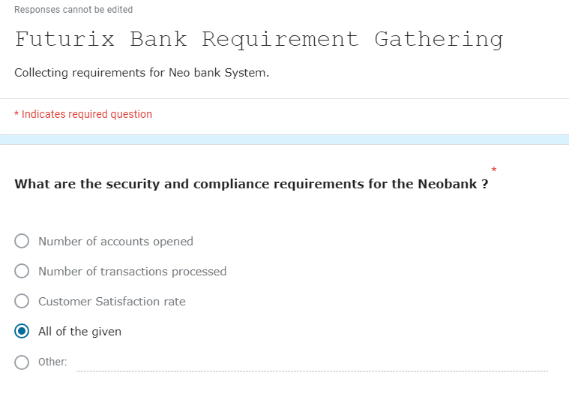
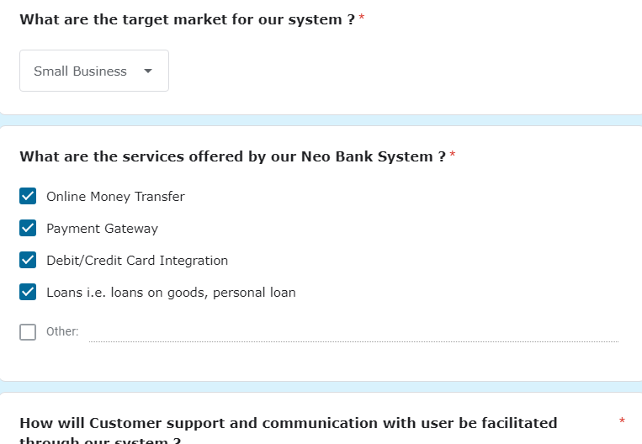
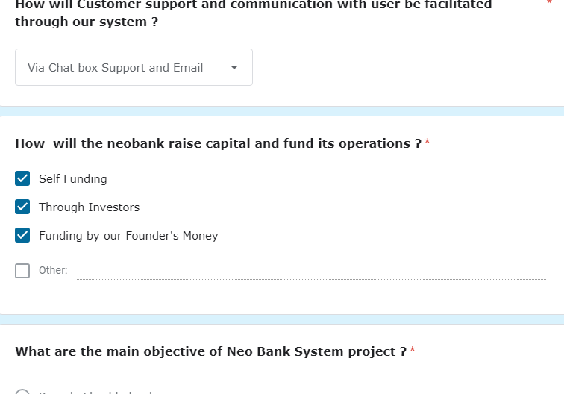
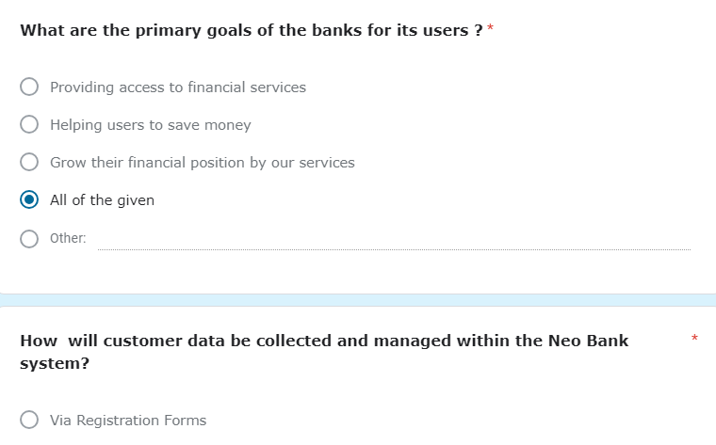
Questions Asked in Interview for Requirement Gathering

Slide 10
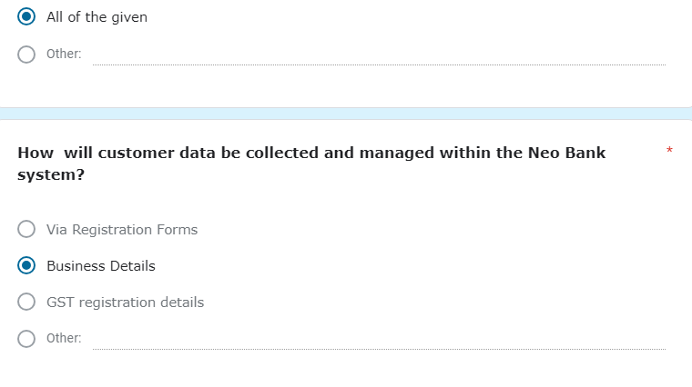

Slide 11
Project Definition
Title : Futurix Bank
The Futurix Bank’s core aim is to break away from traditional banking limitations.
Neo banks prioritize digital accessibility over physical branches.
Operations primarily occur through online platforms rather than physical locations.
Emphasis is placed on user-friendly interfaces, personalized services, and quick transactions.
Neo banks adopt eco-friendly practices by reducing paper usage.
Artificial Intelligence is utilized for effective customer support and personalized experiences.
Lower operational costs result from the absence of physical branches.
Neo banks offer faster, streamlined account opening processes.
Reduced or zero fees for various services are provided.
Universal accessibility is a priority, enabling transactions from anywhere with internet access.

Slide 12
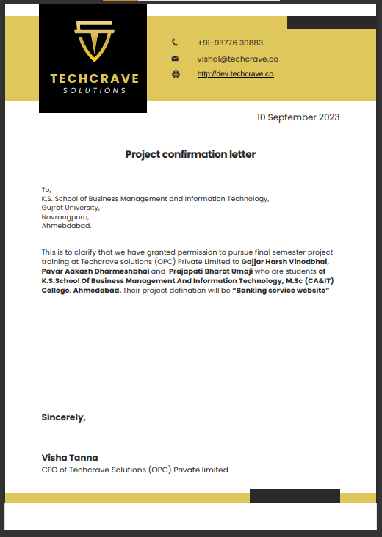
Vishal Tanna

